Slide 1

It’s possible to automate COBOL testing

Slide 2

...but it requires some additional work.

Slide 3
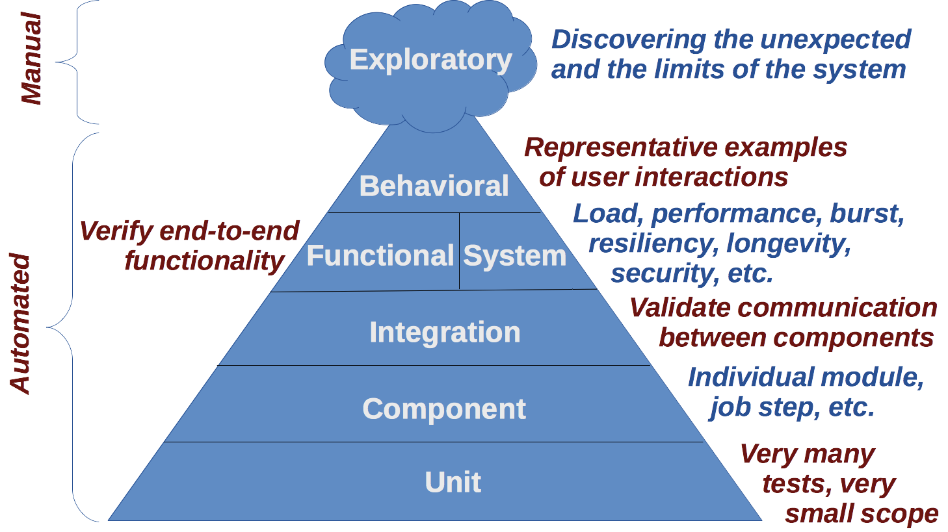
Testing Pyramid (General)

Slide 4
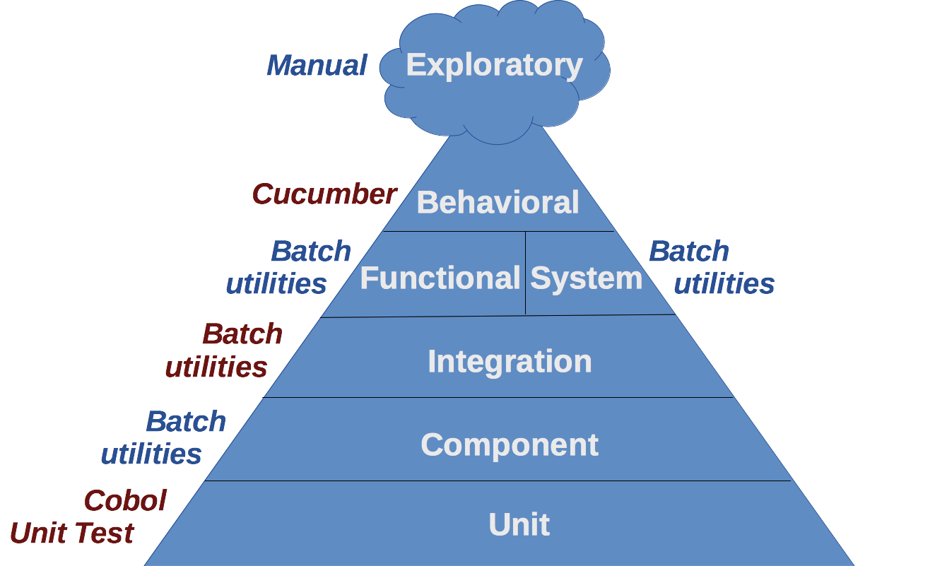
Testing Pyramid (Mainframe Batch)

Slide 5
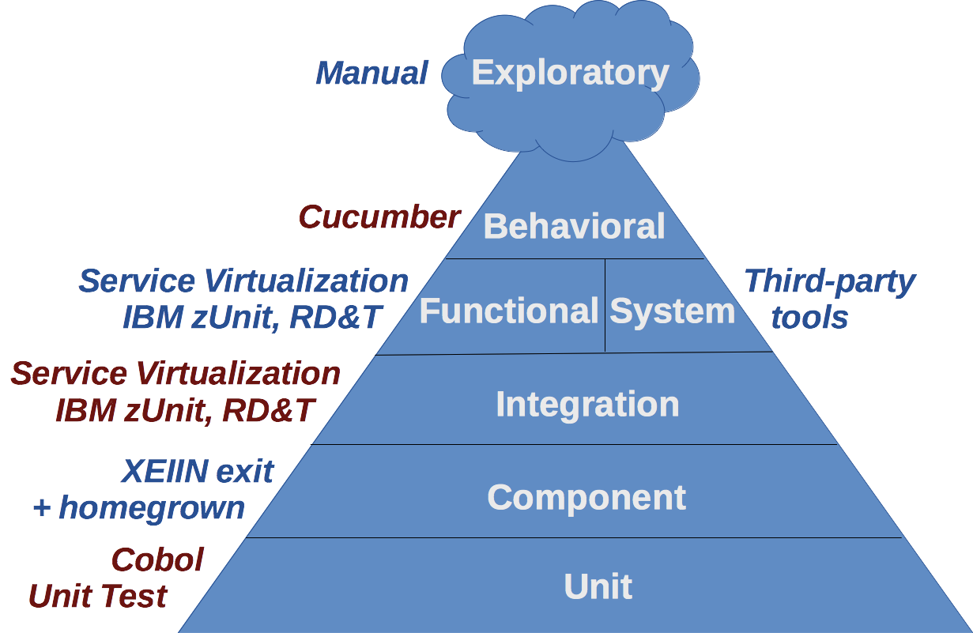
Testing Pyramid (Mainframe CICS)

Slide 6

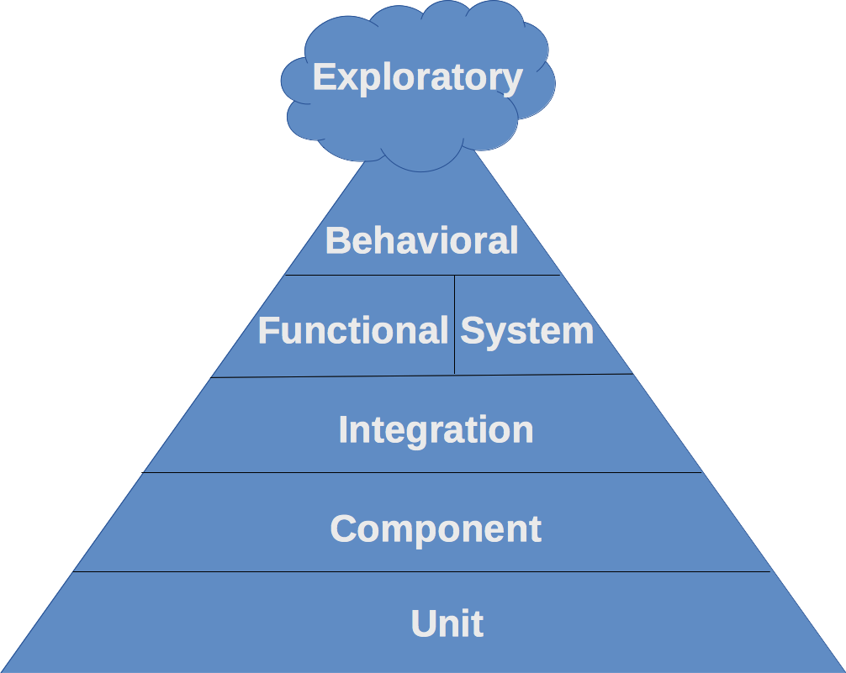
What’s a “Unit Test?”
Single path through the smallest
functional piece of code
Java - a method
C++ - a function
Cobol - a paragraph
All external dependencies are fake
files
databases
network connections
other applications
containers & frameworks
unit

Slide 7
What’s a “Unit Test?”
Single path through the smallest
functional piece of code
Java - a method
C++ - a function
Cobol - a paragraph
All external dependencies are fake
files
databases
network connections
other applications
containers & frameworks
unit

Slide 8
What’s a “Unit Test?”
Single path through the smallest
functional piece of code
Java - a method
C++ - a function
Cobol - a paragraph
All external dependencies are fake
files
databases
network connections
other applications
containers & frameworks
unit

Slide 9
What’s a “Component Test?”
Verifies behavior of a software component
Larger scope than a unit test
Excludes dependencies outside the code under test
component

Slide 10
What’s a “Component Test?”
Batch - a single job step
CICS - a single program or group of collaborating programs
component

Slide 11
What’s an “Integration Test?”
Verifies that two components talk to each other as expected
Normal interaction (“happy path”)
Abnormal interaction (timeouts, exceptions)
Omits the details covered by unit tests - is concerned with integration, not functionality
integration

Slide 12
What’s an “Integration Test?”
Batch: Program handles responses from CALL statements appropriately
Batch: Program handles responses from EXCI calls appropriately
Batch: Program handles responses from MQ Series queues appropriately
integration

Slide 13
What’s an “Integration Test?”
CICS: Program handles responses from XPI calls appropriately
CICS: Program handles responses from XMS calls appropriately
CICS: Program handles responses from MQ Series queues appropriately
integration

Slide 14
What’s an “API Test?”
Verifies client interaction with a programmatic API (usually a SOAP-based or RESTful API)
A kind of integration test
Probably not relevant to mainframe systems
integration

Slide 15
What’s a “Functional Test?”
A single path through the application for a single transaction
End-to-end test with external interfaces live
Usually omits the UI but touches all other architectural layers in the application
functional

Slide 16
What’s a “Functional Test?”
Batch: A jobstream
CICS: An end-to-end transaction, possibly skipping the UI and LINKing to the initial program
functional

Slide 17
What’s a “GUI Test?”
Exercises an application through its user interface
Also known as “behavioral test”
Examples of representative interactions
The basis of Acceptance Test Driven Development
behavioral

Slide 18
What’s a “GUI Test?”
Batch: N/A
CICS: End-to-end test against the UI
behavioral

Slide 19
Unit
unit

Slide 20
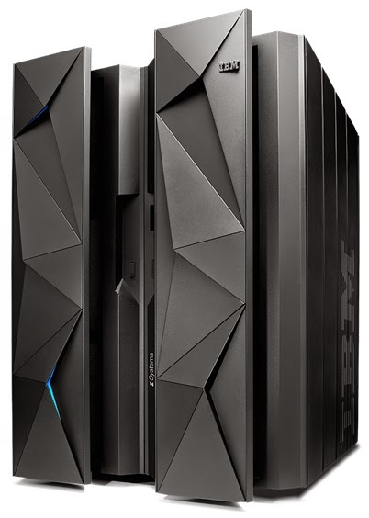
Mainframe Unit Testing On-Platform
Java on USS
Cobol Unit Test
unit

Slide 21
Mainframe Unit Testing Off-Platform
IBM zUnit with RD&T and Greenhat
Cobol Unit Test on
Linux or Windows
unit

Slide 22
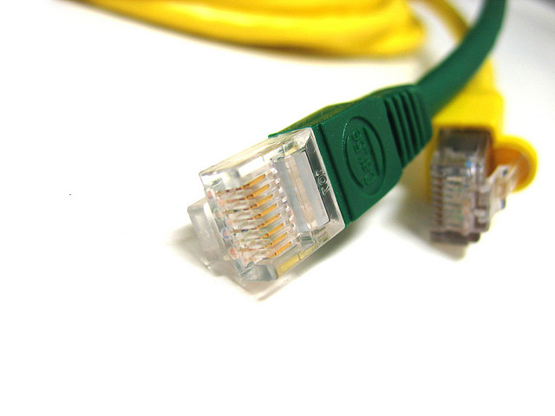
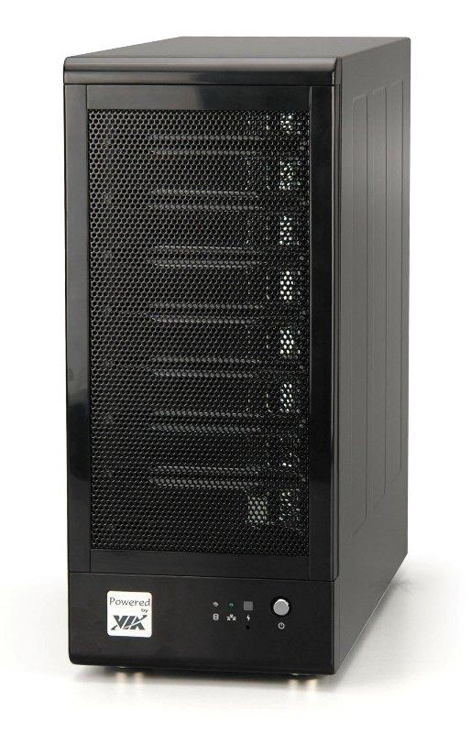



Ideally, unit testing requires no
connectivity to external resources
unit

Slide 23
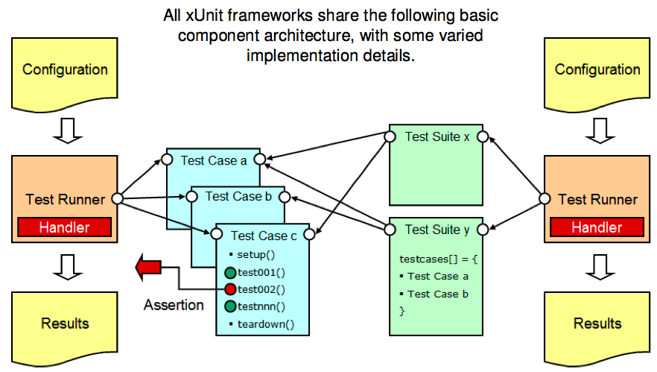
Tooling: xUnit Architecture
unit
Venkat Balabhadrapatruni
Chief Architect, RDz (IBM)

Slide 24
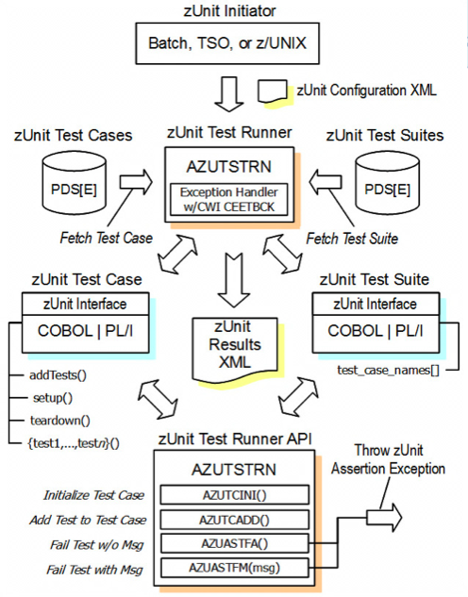
zUnit: A DSL for zOS unit testing
unit
Venkat Balabhadrapatruni
Chief Architect, RDz (IBM)

Slide 25
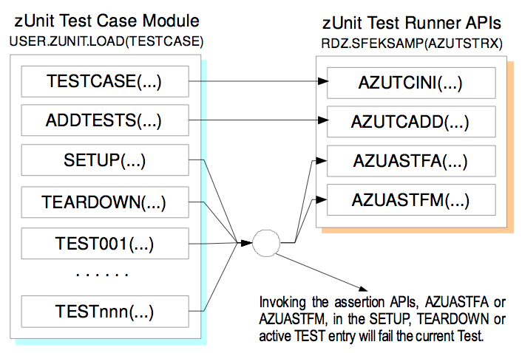
zUnit Implementation of xUnit
unit
Venkat Balabhadrapatruni
Chief Architect, RDz (IBM)

Slide 26
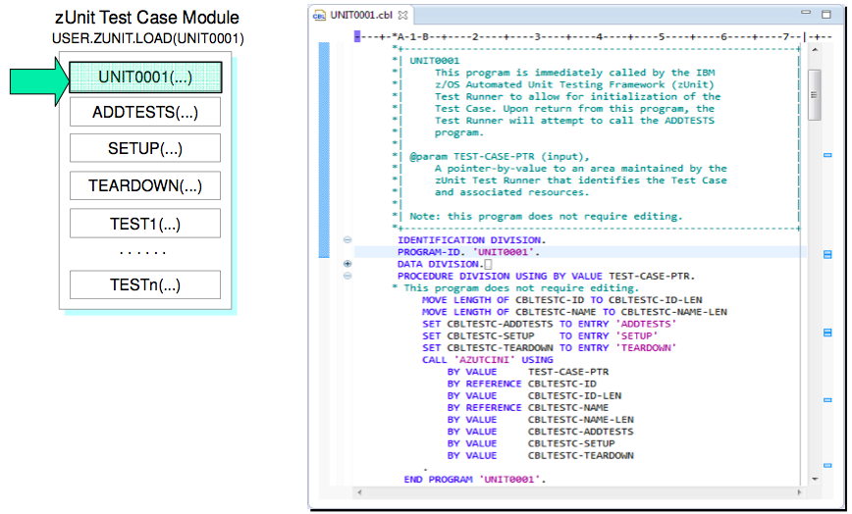
Sample zUnit Test Case for Cobol (1)
unit
Venkat Balabhadrapatruni
Chief Architect, RDz (IBM)

Slide 27
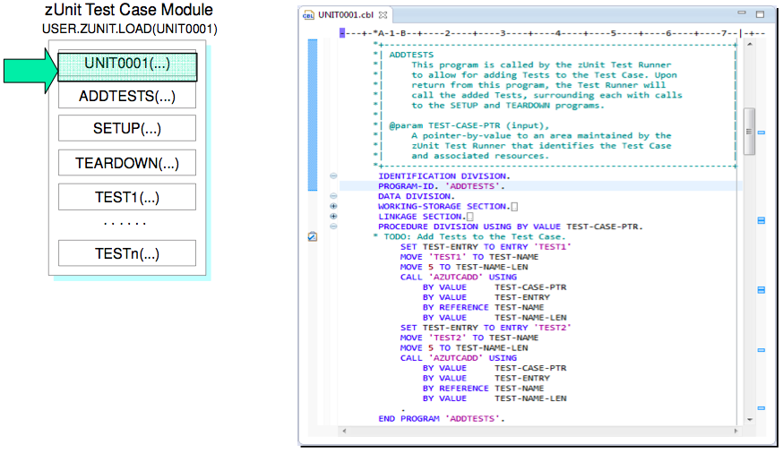
Sample zUnit Test Case for Cobol (2)
unit
Venkat Balabhadrapatruni
Chief Architect, RDz (IBM)

Slide 28
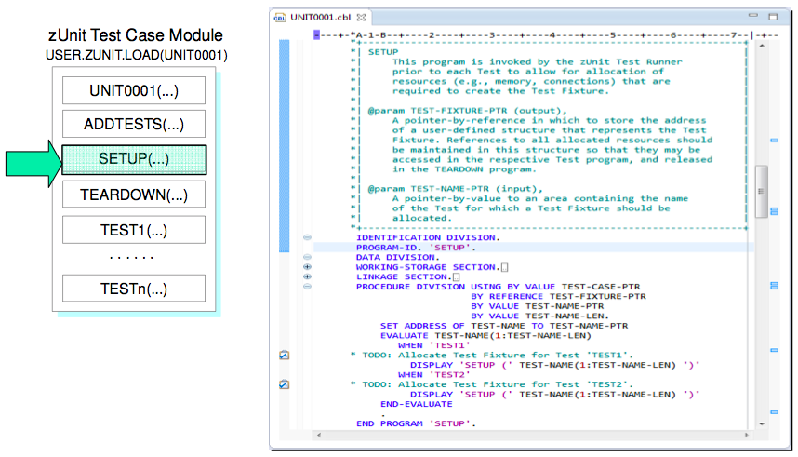
Sample zUnit Test Case for Cobol (3)
unit
Venkat Balabhadrapatruni
Chief Architect, RDz (IBM)

Slide 29
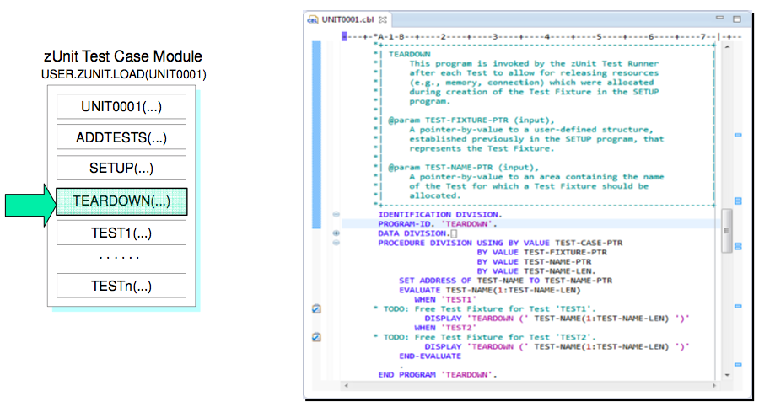
Sample zUnit Test Case for Cobol (4)
unit
Venkat Balabhadrapatruni
Chief Architect, RDz (IBM)

Slide 30
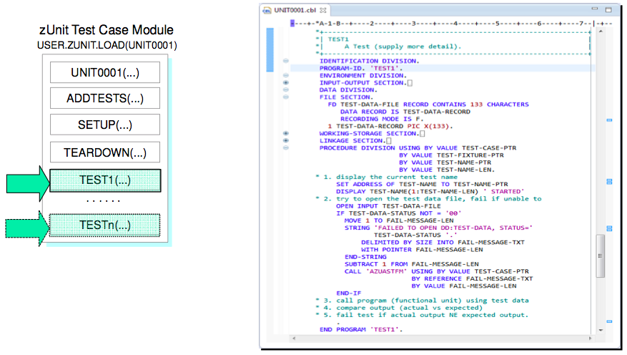
Sample zUnit Test Case for Cobol (5)
unit
Venkat Balabhadrapatruni
Chief Architect, RDz (IBM)

Slide 31

What a clumsy DSL feels like

Slide 32
cobol-unit-test: A DSL for unit testing Cobol
TESTSUITE 'Convert CSV file to fixed format'
TESTCASE 'It converts text field 1 to upper case'
MOVE 'something' TO TEXT-VALUE-1
PERFORM 2100-CONVERT-TEXT-FIELD-1
EXPECT TEXT-OUT-1 TO BE 'SOMETHING'
TESTCASE 'It handles empty text field 1'
MOVE LOW-VALUES TO TEXT-VALUE-1
PERFORM 2100-CONVERT-TEXT-FIELD-1
EXPECT TEXT-OUT-1 TO BE SPACES
2100-CONVERT-TEXT-FIELD-1.
IF TEXT-VALUE-1 = LOW-VALUES
MOVE SPACES TO TEXT-OUT-1
ELSE
MOVE TEXT-VALUE-1 TO TO-UPPER-CASE
PERFORM 9000-TO-UPPER-CASE
MOVE TO-UPPER-CASE TO TEXT-OUT-1
END-IF
.
unit

Slide 33

What a natural DSL feels like

Slide 34

What are “test doubles?”
test double : external resource
=
stunt double : actor

Slide 35
Everything is Real
External
Resource
1
External
Resource
2
Production
Code
External
Resource
3
External
Resource
4

Slide 36
Only the Code Under Test is Real
Test
Double
1
Test
Double
2
Test
Driver
Code
Under
Test
Test
Double
3
Test
Double
4

Slide 37
Test Doubles
Stub - returns lowest-common-denominator result based on the type of resource it represents
Mock - returns a value specified in the test case; keeps track of how many times it was accessed
Virtualized Service - mimics the behavior of a service interface
Simulator or emulator - a custom implementation of a resource intended to support testing or experimentation

Slide 38
External Resources of COBOL Programs
Files (batch)
Paragraphs
CALLs
this covers MQI and XMS
EXEC CICS commands
EXEC SQL commands

Slide 39
Component
component

Slide 40
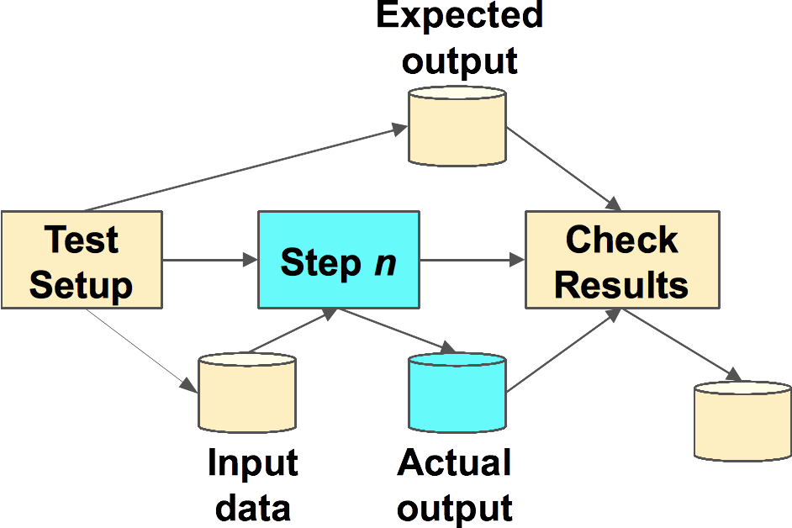
Component Test (Batch)
component

Slide 41
Batch Component Test: Setup
000001 //UMGP409A JOB (15901,TEST,000000),'MOB TDD JCL',
000002 // CLASS=6,MSGCLASS=X,NOTIFY=&SYSUID
000003 // SET HLQ=TPS
000004 // SET ENV=T01
000005 // SET FA=B1
000006 // SET ODATE=141006
000007 // SET JOBNAME=PPSTDDT1
000008 // SET DB2ENV=TDB2
000009 //*******************************************
000010 //PROCLIB JCLLIB ORDER=(TPS.UMGP409.MOB.PRC,
000011 // PRD1.BNVSM.PROCFIX,
000012 // PRD1.BNVSM.PROCLIB)
000013 //*******************************************
000014 //JOBLIB DD DSN=TPS.UMGP409.UMM.P2.LOD,
000015 // DISP=SHR
000016 // DD DSN=PRD1.BNVSM.LOADFIX,
000017 // DISP=SHR
000018 // DD DSN=PRD1.BNVSM.PPS.LOADLIB,
000019 // DISP=SHR
000020 // DD DSN=PRD1.BNVSM.PTSA.LOADLIB,
000021 // DISP=SHR
000022 // DD DSN=&DB2ENV.GRP.RUNLIB.LOAD,
000023 // DISP=SHR
000024 // DD DSN=&DB2ENV.GRP.SDSNLOAD,
000025 // DISP=SHR
component

Slide 42
Batch Component Test: Test Case
000026 //***************************************
000027 //* DELETE ERROR REPORT
000028 //*****************************************
000029 //CLRFRPT EXEC PTSADELF,
000030 // DSN=&HLQ..&ENV..&FA..D.&JOBNAME..FAIL.REPORT
000032 //*****************************************
000033 //* TEST CASE 01
000034 //*****************************************
000035 //JSDELDF EXEC PTSADELF,
000036 // DSN=&HLQ..&ENV..&FA..D.&JOBNAME..TC001.SYSOUT
000037 //*****************************************
000038 //TC001 EXEC PPSRCVRT,
000039 // ODATE=&ODATE,
000040 // ACHRECV=TPS.UMGP409.ACH.EMPTY,
000041 // RESULT=&HLQ..&ENV..&FA..D.&JOBNAME..TC001.SYSOUT
000042 //****************************************
000043 //SUPTC001 EXEC SUPERCF,
000044 // RESULT=&HLQ..&ENV..&FA..D.&JOBNAME..TC001.SYSOUT,
000045 // REFDD=TPS.UMGP409A.TC001.SYSOUT.REF
000046 //****************************************
000047 //IFBAD IF SUPTC001.SUPERC.RC NE 0 THEN
000048 //PPSERRPT EXEC PPSERRPT
000049 //RUNEXEC.SYSTSIN DD *
000050 TPS.T01.B1.D.PPSTDDT1.FAIL.REPORT TC001
000051 //IFBADEND ENDIF
component

Slide 43
Batch Component Test: Wrapping Up
000152 //**************************************************
000153 //* AT LAST - WHEN ALL TEST CASES SUCCESSFULLY PASSED
000154 //**************************************************
000155 //PPSATLST EXEC PPSATLST
000156 //EMYRPT.SYSIN DD *
000157 LISTCAT ENTRIES('TPS.T01.B1.D.PPSTDDT1.FAIL.REPORT') ALL
000158 /*
000159 //IFDNEXT IF PPSATLST.EMYRPT.RC GT 0 THEN
000160 //PPSSUCCS EXEC PPSSUCCS,
000161 // RPTDSN=TPS.T01.B1.D.PPSTDDT1.FAIL.REPORT
000162 //IFDNEXTE ENDIF
000163 //
component

Slide 44
Batch Component Test: Test Report (1)
000001 /* REXX */
000020 PULL OUTDSN TTDTESTCASE
000021 IF SYSDSN("'"OUTDSN"'") = 'OK' THEN
000022 DO
000023 SAY 'OUTDSN IN OK' OUTDSN
000024 "ALLOC F(EXISTS) DS('"OUTDSN"') REUSE SHR"
000025 "EXECIO 0 DISKR EXISTS (OPEN"
000026 "EXECIO * DISKR EXISTS (STEM XX."
000027 "EXECIO 0 DISKR EXISTS (FINIS"
000028 "FREE F(EXISTS)"
000029 I = 1
000030 M = XX.0 + 1
000031 SAY 'XX.0' XX.0
000032 DO WHILE I <= XX.0
000033 OUTVR.I = XX.I
000034 I = I + 1
000035 "ALLOC F(OUT) DS('"OUTDSN"') OLD SHR SPACE(50,20) REUSE
000036 DSORG(PS) RECFM(F,B) LRECL(80) BLKSIZE(0)"
000037 "EXECIO 1 DISKW OUT (STEM OUTVR. FINIS"
000038 "FREE F(OUT)"
000039 END
000040 END
...
component

Slide 45
Batch Component Test: Test Report (2)
...
000041 ELSE
000042 SAY 'OUTDSN IN NOT OK' OUTDSN
000043 "ALLOC F(OUT) DS('"OUTDSN"') NEW MOD SPACE(50,20)
000044 DSORG(PS) RECFM(F,B) LRECL(80) BLKSIZE(0)"
000045 OUTVR.1 = TTDTESTCASE
000046 "EXECIO * DISKW OUT (STEM OUTVR. FINIS"
000047 "FREE FILE(OUT)"
000048 EXIT 00
component

Slide 46
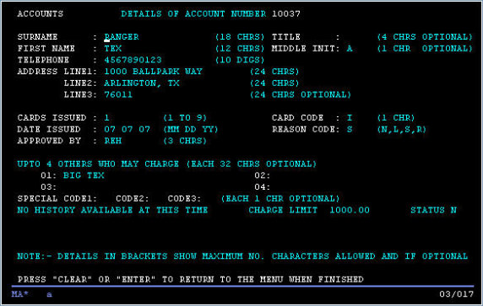
CICS Component Testing
Options
A mocking framework
Service Virtualization
component

Slide 47
CICS Component Testing
Mocking framework
Pros
Lightweight
Fast
Easy to use
No additional resources needed
Cons
No such beast exists - must write it
component

Slide 48
CICS Component Testing
Service Virtualization
Pros
Configurable
Can learn existing interactions
Production-like environment
Cons
Heavyweight - much setup needed
Multiple servers needed
Multiple points of failure
Third-party products ($$$)
More suited to functional testing
component

Slide 49
CICS Component Testing (Proposed)
Test Runner
(Java)
Test Runner
(.NET)
Test Runner
(other)
Tests
Tests
Tests
zOS
TS Gateway
TS Gateway
MQSeries
CICS
Parsed
Mock
Specs
(memory)
Test Runner
(batch)
Test Driver
EXCI
Program A
XEIIN
Exit
Tests
START
WRITEQ
MQPUT
EXEC CICS...
If mocked:
Bypass command
Set mock data
Tally accesses
Program B
component

Slide 50
Integration
integration

Slide 51
Integration Test (General)
Production
Component A
Component B
interfaces and/or adapters
Does Component A handle everything defined in Component B’s interface?
Component A
Test Double
integration

Slide 52
Integration Test (MQSeries)
Test
Queue
Test Driver
Component A
Component A knows how to retrieve data from a queue
Component A knows how to handle all the inputs that are defined for this interface
integration

Slide 53
Integration Test (API)
Mock
Service
Test Driver
Component A
Component A knows how to interact with the defined API
Component A knows how to handle all the inputs that are defined for this interface
integration

Slide 54
Integration Test (Third-party Supplier)
Mock
Data
Source
Test Driver
Component A
Component A knows how to interact with the defined data feed
Component A knows how to handle all the inputs that are defined for this interface
integration

Slide 55
Functional
functional

Slide 56
Functional Test (General)
Test
Driver
Conditioned
Reference
Data
Test Input
Data
Component
A
Component
A
Component
B
Component
A
Component
C
functional

Slide 57
Functional Test with External Dependencies
Test
Driver
Conditioned
Reference
Data
Test Input
Data
Component
A
Component
A
Component
B
Component
A
Component
C
Mock
functional
External
System

Slide 58
Service Virtualization
Real
Queue
Fake
Real
DB2 call
Application
Fake
Real
Other
protocol
functional
Fake

Slide 59
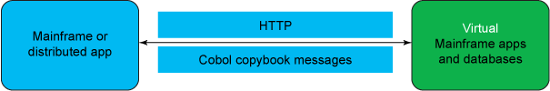
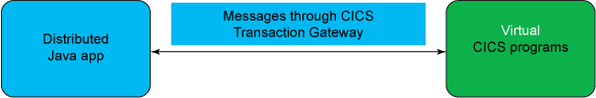
IBM Service Virtualization
Scenario 1:
Mainframe or distributed app calls CICS program with HTTP
Scenario 2:
Distributed application calls CICS program through CICS Transaction Gateway
http://www.ibm.com/developerworks/rational/library/automated-mainframe-testing/

Slide 60
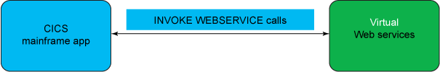
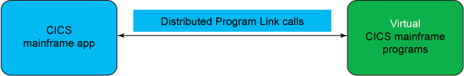
IBM Service Virtualization (2)
Scenario 3:
CICS program calls a web service with INVOKE WEBSERVICE calls
Scenario 4:
CICS program calls another CICS program with distributed program link

Slide 61
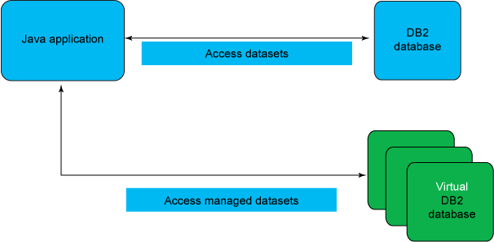
IBM Service Virtualization (3)
Scenario 5: DB2 database virtualization
functional

Slide 62
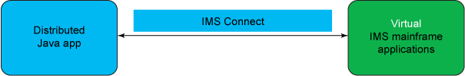
IBM Service Virtualization (4)
Scenario 6: IMS virtualization
functional

Slide 63
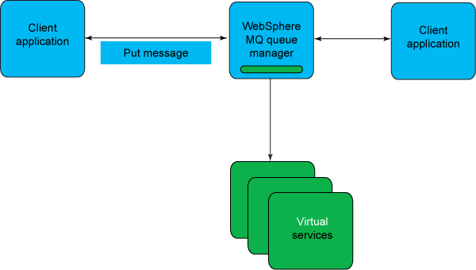
IBM Service Virtualization (5)
Scenario 7: WebSphere MQ virtualization
functional

Slide 64
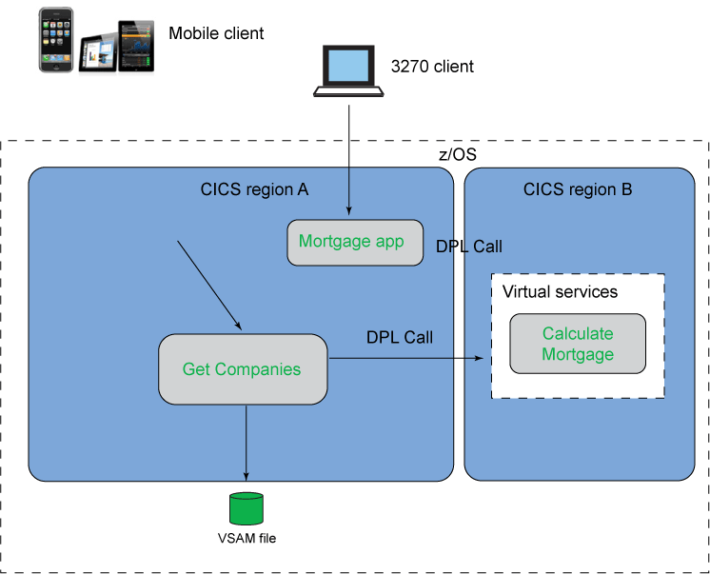
IBM Service Virtualization (6)
Scenario 8: CICS DPL virtualization

Slide 65
System
system

Slide 66
System Testing
Validate:
“system attributes,” a.k.a.
“system qualities,” a.k.a.
“non-functional requirements”
Examples:
Load testing
Longevity testing
Burst testing
Security testing
Performance testing
Out of scope for this session
system

Slide 67
Behavioral
behavioral

Slide 68
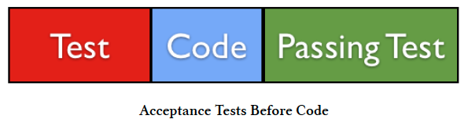
What is Acceptance Test Driven Development (ATDD)?
Industry practice in which whole team collaborates on
  acceptance criteria and the definition of done
Automate acceptance tests while production code is being developed
  automation completes before development
Developer focuses on making acceptance tests pass

Slide 69
ATDD Workflow: Pre-Sprint
SPECIFICATION | ELABORATION | READY
Write initial specification and specific examples for a user story. Feature stories follow the format: “As a <persona> I want to <to take action> so that <desired result or expectation>” User stories are written in Gherkin with the format: “Given / When / Then” | Elaborate Gherkin Evaluate Gherkin for: Completeness Additional scenarios Edge cases or other impacts Test data required | Stories elaborated Examples are specific and complete Gherkin is complete
Developer
Tester
BSA
PO
UI
PO
BSA
(only when needed)
PO
BSA

Slide 70
ATDD Workflow: In-Sprint
READY | DEVELOPMENT | REVIEW | DONE
Stories elaborated (Pre-sprint) Examples are specific and complete Gherkin is complete Ready for development | 3 Amigos (for each story) ~ 10 minutes Questions about story: Doable? Complete? Are we on the same page? Tester: Automates story by writing Ruby/Cucumber scripts (functional tests) Developer: Executes failing test and begins development (including unit tests) with the goal to make the functional tests pass | Tests pass unit acceptance Tester + Developer: Demo work completed on a story and passing tests PO: Reviews Accepts / Reject | Story has been tested, reviewed and accepted
Developer
BSA
Tester
(available for questions)
PO
BSA
UI
BSA
PO
PO

Slide 71
ATDD Workflow: In-Sprint
red: failing test
green: passing test
blue: test automation
gold: unit tests
1
Gherkin
red
2
Cucumber test scripts
3
Unit
tests
Application Code
red
4
refactor
5
green
6
green
refactor
7

Slide 72
Build Pipeline
Application Code
Test Code
Multiple builds running throughout the day
Each stage executes if the previous stage executes successfully
SVN
Checkout
Compile
Unit Tests
Pass
Acceptance Tests
Pass
Integration
Tests
Deploy
Promote
Fail
Fail
Fail
Notification

Slide 73

Test automation using Cucumber
User Story
*.feature
*_steps.rb
Gems
Third party libraries with specific capabilities
Map of steps in scenarios contained in Gherkin
Reusable modules
Domain specific helper modules
Given
When
Then
Wrapper classes for application elements
(Page Objects)
Features with scenarios (Gherkin)
These are functional tests
Step Definitions
mainframe
mobile application
Cucumber
(Test automation tool for executing tests)
Web application
command line application

Slide 74
User Story
BSA + PO
Open Source libraries
Gems
Third party libraries with specific capabilities
BSA + Tester
Tester
(some developer help)
*.feature
*_steps.rb
Map of steps in scenarios contained in Gherkin
Reusable modules
Domain specific helper modules
Given
When
Then
Wrapper classes for application elements
(Page Objects)
Features with scenarios (Gherkin)
These are functional tests
Step Definitions
Developer
mainframe
mobile application
Cucumber
(Test automation tool for executing tests)
Web application
command line application

Slide 75
Cucumber Example: Feature File
Feature: Find coffee
As a coffee lover
I want to locate good coffee
So I can start each day with a smile
Scenario: The search ends well
Given I am on Amazon
When I search for "Ravens Brew"
Then I find what I am looking for
Scenario: The search ends badly
Given I am on Amazon
When I search for "Vlorch Zlongg"
Then I find nothing

Slide 76
Cucumber Example: Steps File
Given /^I am on Amazon$/ do
visit_page AmazonPage
end
When(/^I search for "(.*?)"$/) do |query_value|
@current_page.query = query_value
@current_page.submit
end
Then(/^I find nothing$/) do
@current_page.no_results?
end
Then(/^I find what I am looking for$/) do
@current_page.results?
end

Slide 77
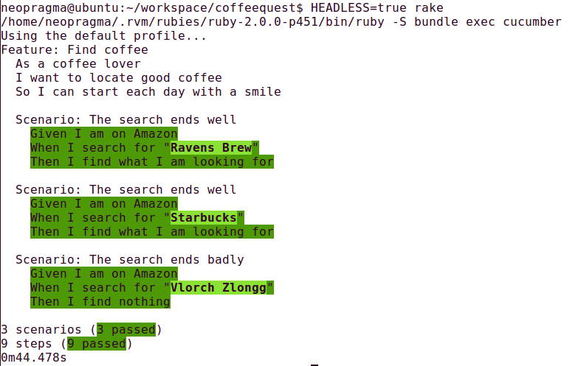
Cucumber Example: Execution

